Slide 1


CASE III Reddit WallStreetBets ANALYSIS
CSCI E-89B Introduction to Natural Language Processing
Gordon Hew
May 6th, 2021

Slide 2
OUTLINE
Background
Objective
Data & Approach
Analysis
Conclusions

Slide 3
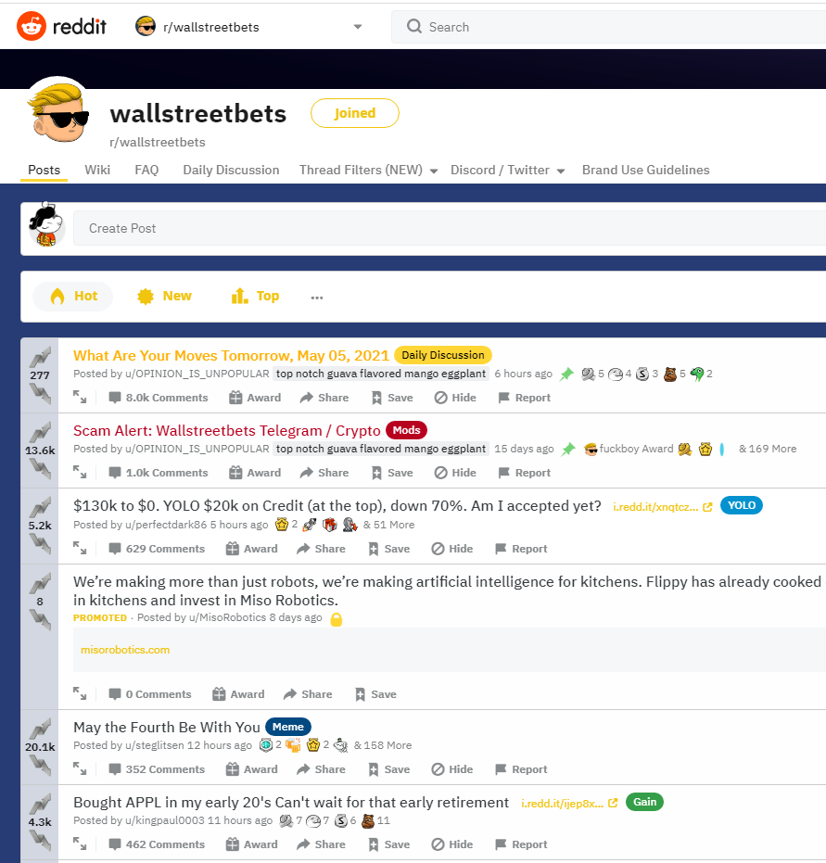
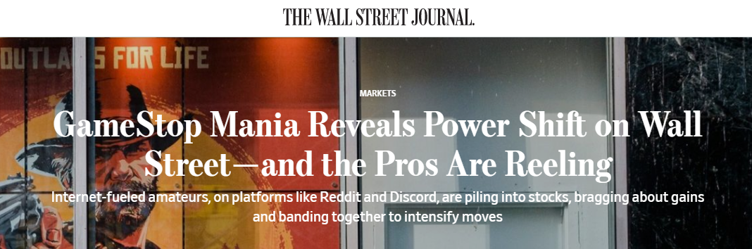
What is WallStreetBets? Why do we care?
According to the mods at r/wallstreetbets:
“/r/wallstreetbets is a community for making money and being amused while doing it. Or, realistically, a place to come and upvote memes when your portfolio is down.”
-https://www.reddit.com/r/wallstreetbets/wiki/faq#wiki_the_wsb_faq

Slide 4
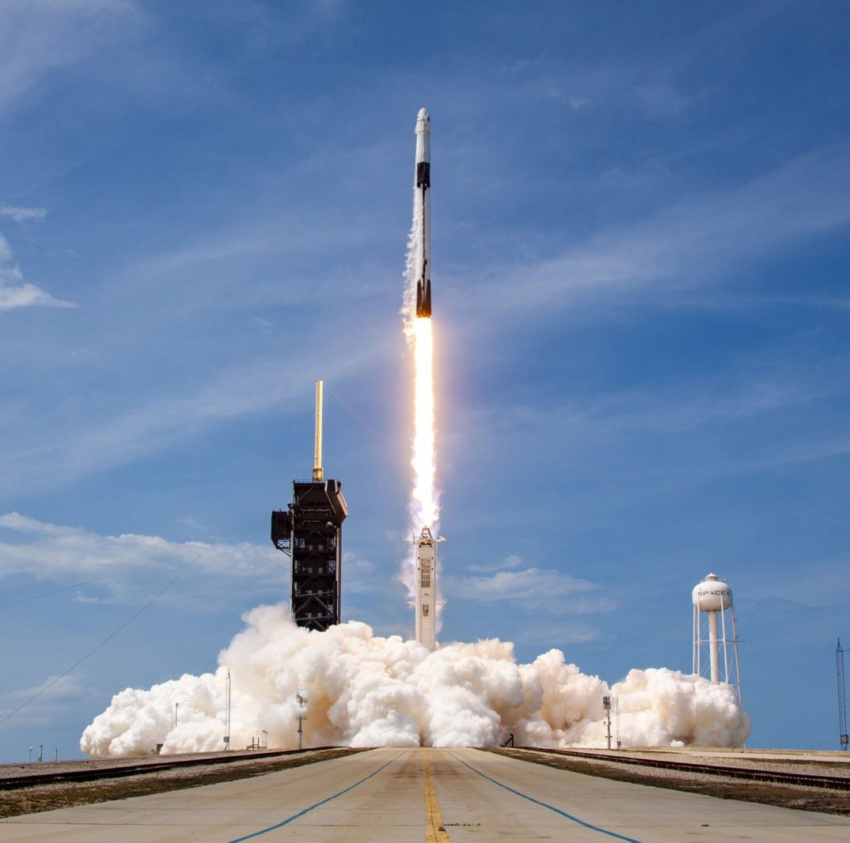
Objective
By applying NLP Techniques to social media data, we want to look for “signals” of the next potential opportunity that can take us “to the moon” 🚀🚀🚀

Slide 5
Data and Approach
Data
Approach
Source: course extraction from the Reddit’s Wall Street Bets subreddit: https://www.reddit.com/r/wallstreetbets/
Market and Reddit Data from 5/31/2019 – 2/2/2021
50 Total Posts
18,940 Total Comments
Reddit data contains
Post Data: Date, Title, Text Body , Post Score, Upvote Proportion, Links
Comment Data: Date, Text
Divide post and comment information
Prepare raw data for text processing
Apply exploratory data analysis techniques:
Temporal Analysis of market data and social media data
Examine word frequencies, associations
Extract Bigrams
Perform Latent Dirichlet Allocation (LDA) clustering
Sentiment Analysis

Slide 6
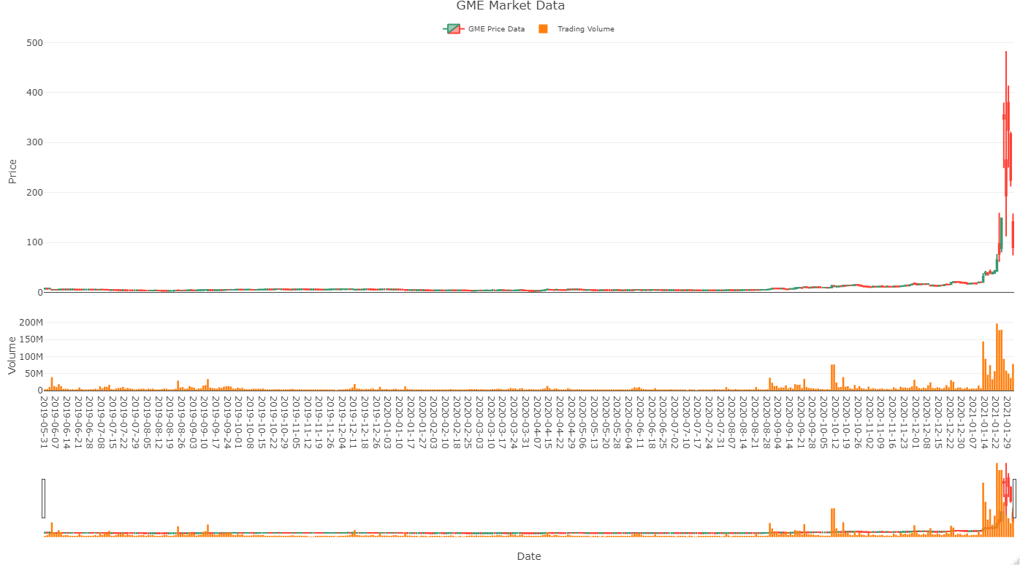
Analysis: historical GME Market DATA

Slide 7
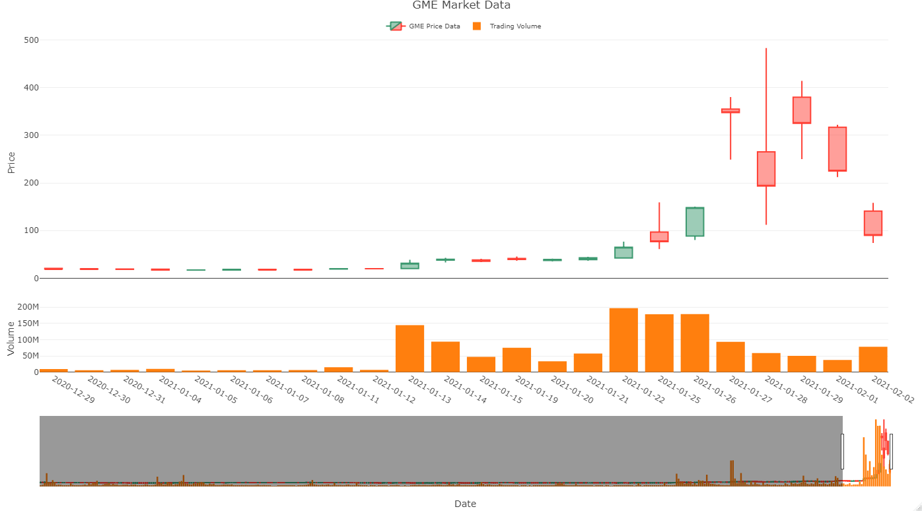
Analysis: GME Market DATA During Wallstreet bets mania

Slide 8
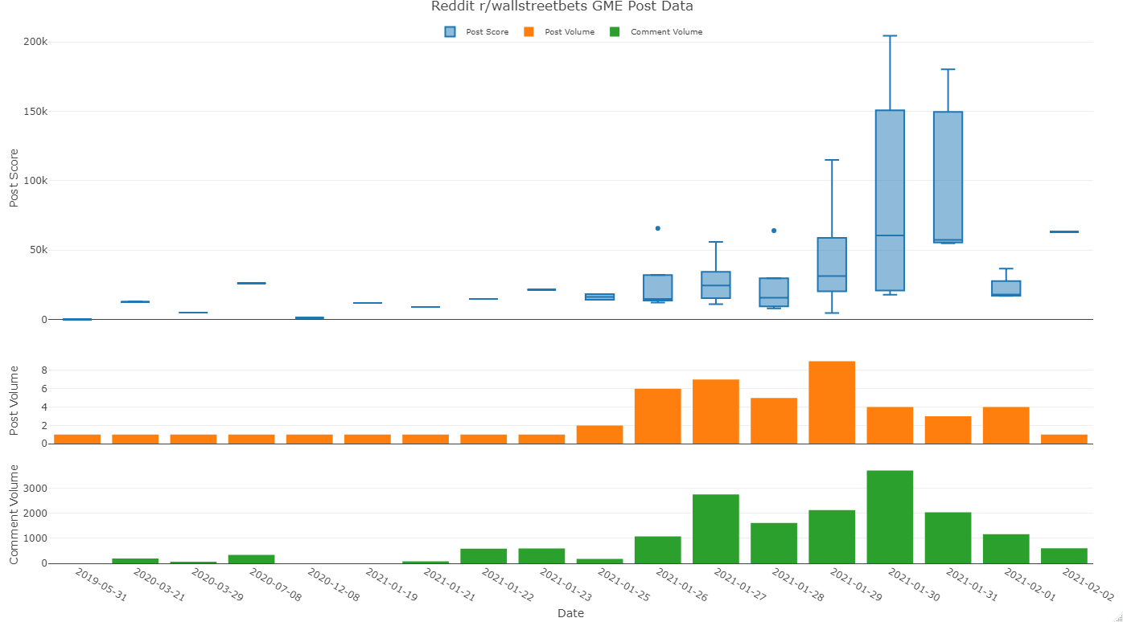
Analysis: GME Market DATA During Wallstreet bets mania

Slide 9
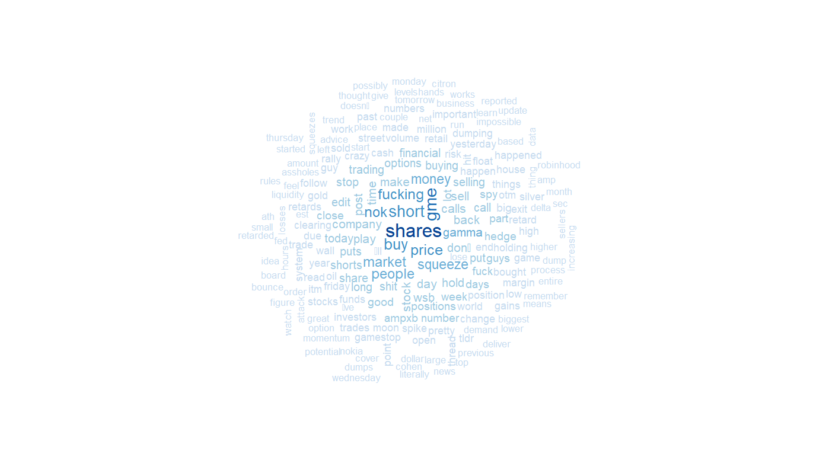
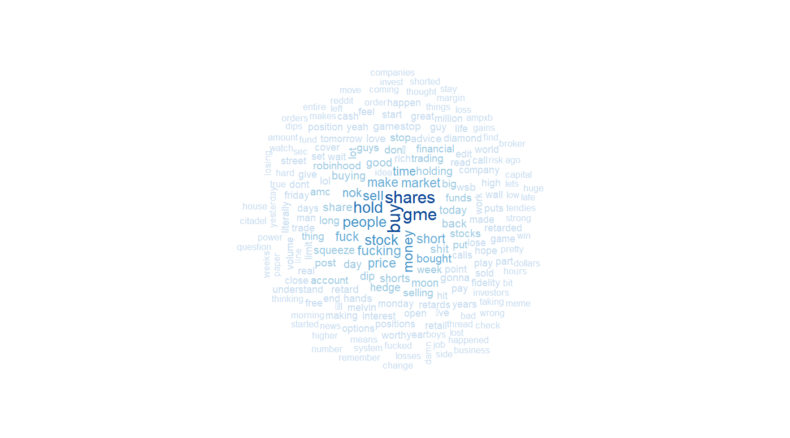
ANALYSIS: Word Clouds
Post Body Word Cloud
Comment word cloud

Slide 10
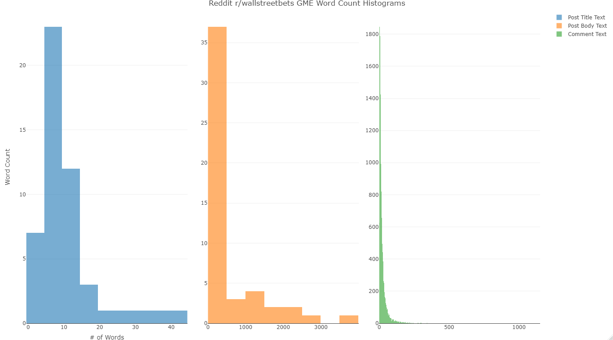
ANALYSIS: Word count histograms

Slide 11
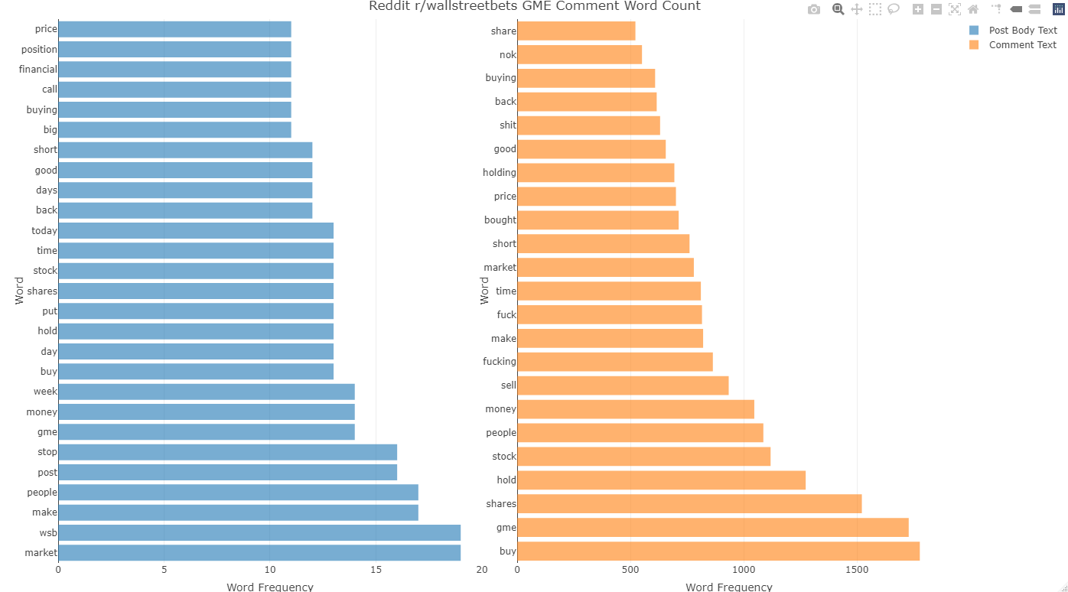
ANALYSIS: TOP Word FREquencies

Slide 12
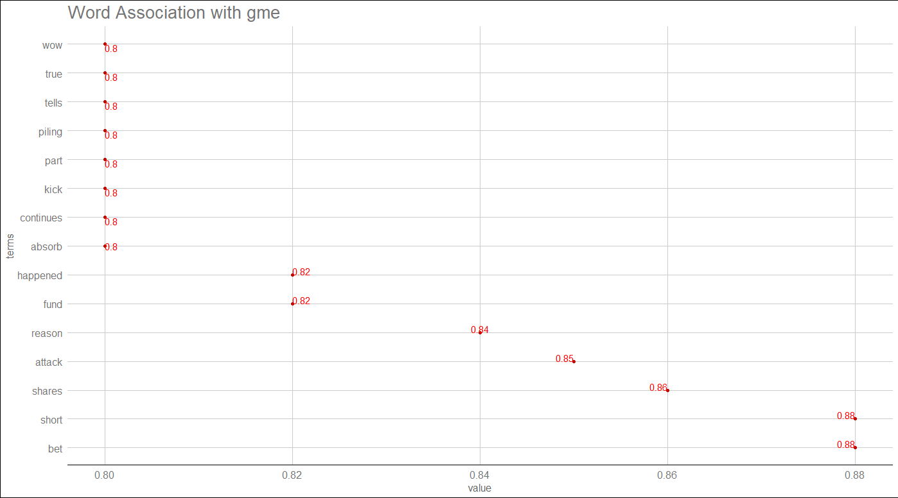
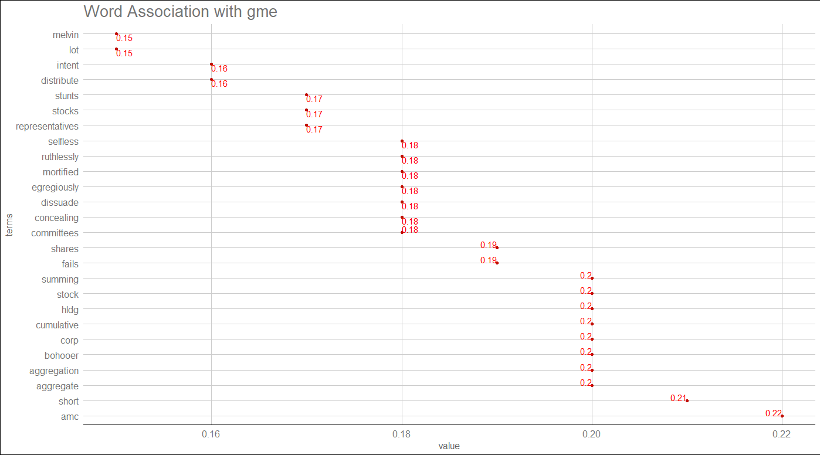
Analysis: Word Associations
Post Text word association
Comments word association

Slide 13
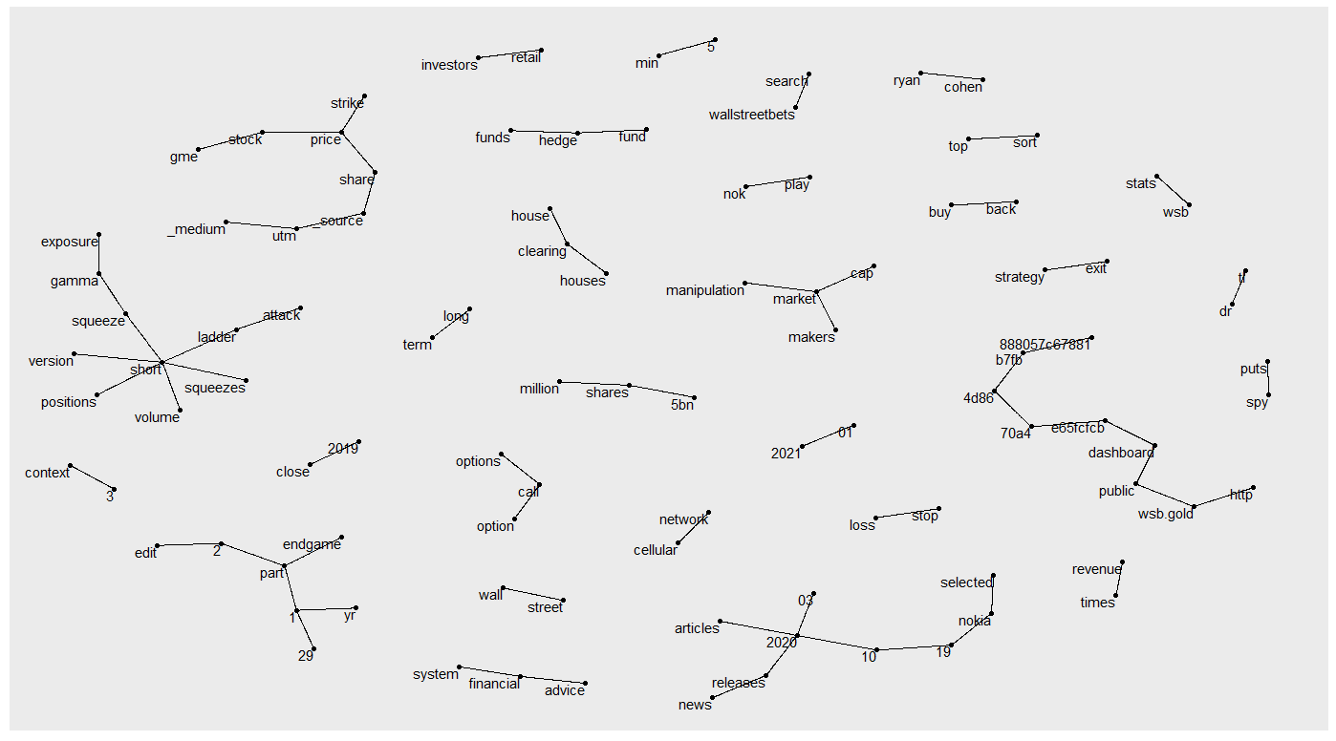
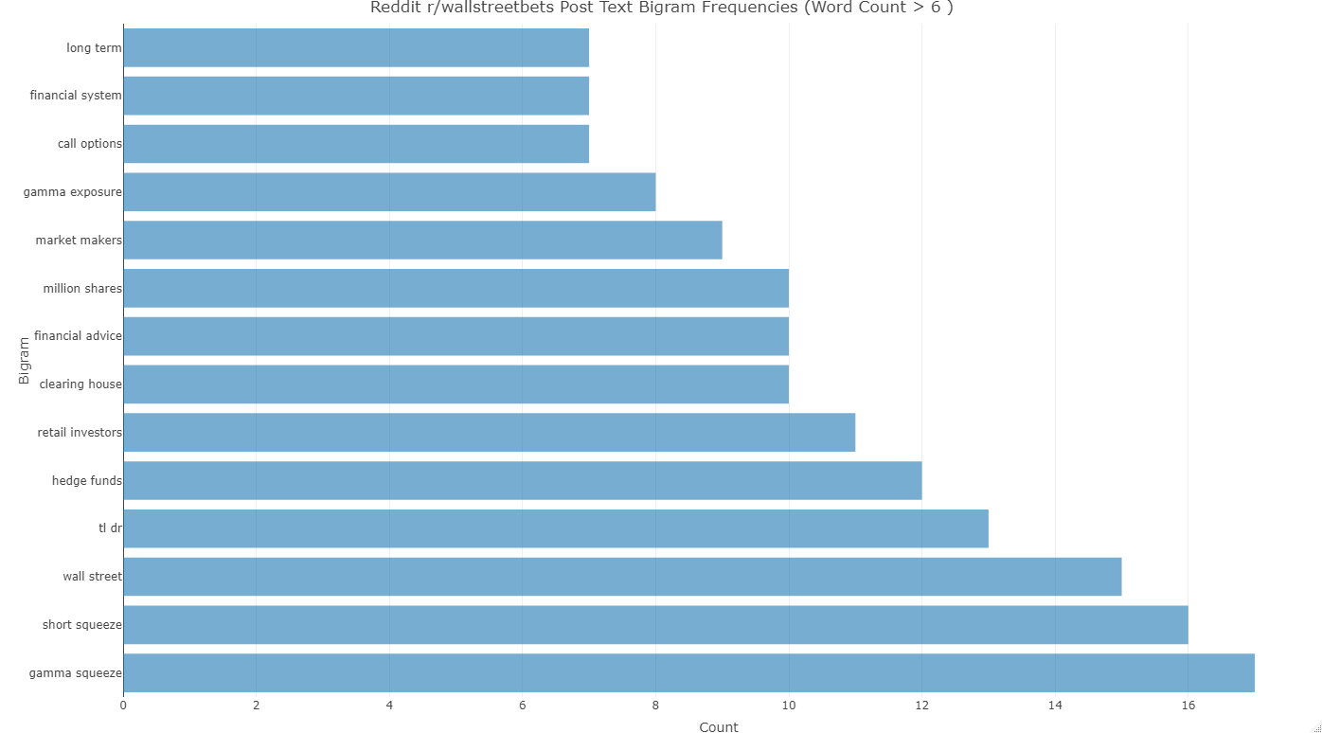
Analysis: BIGRAM Post body text Analysis
BIGRAM Graph
BiGRAM Frequencies

Slide 14
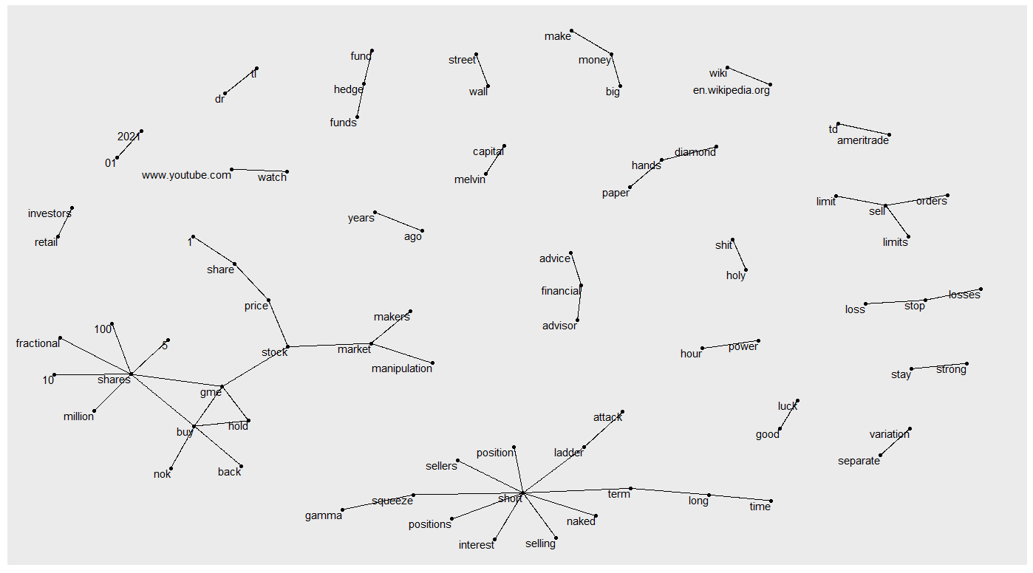
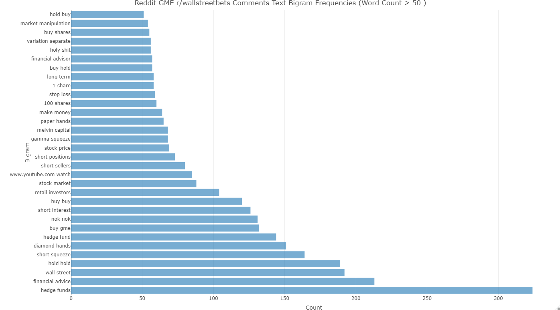
Analysis: BIGRAM comments Analysis
BIGRAM Graph
BiGRAM Frequencies

Slide 15
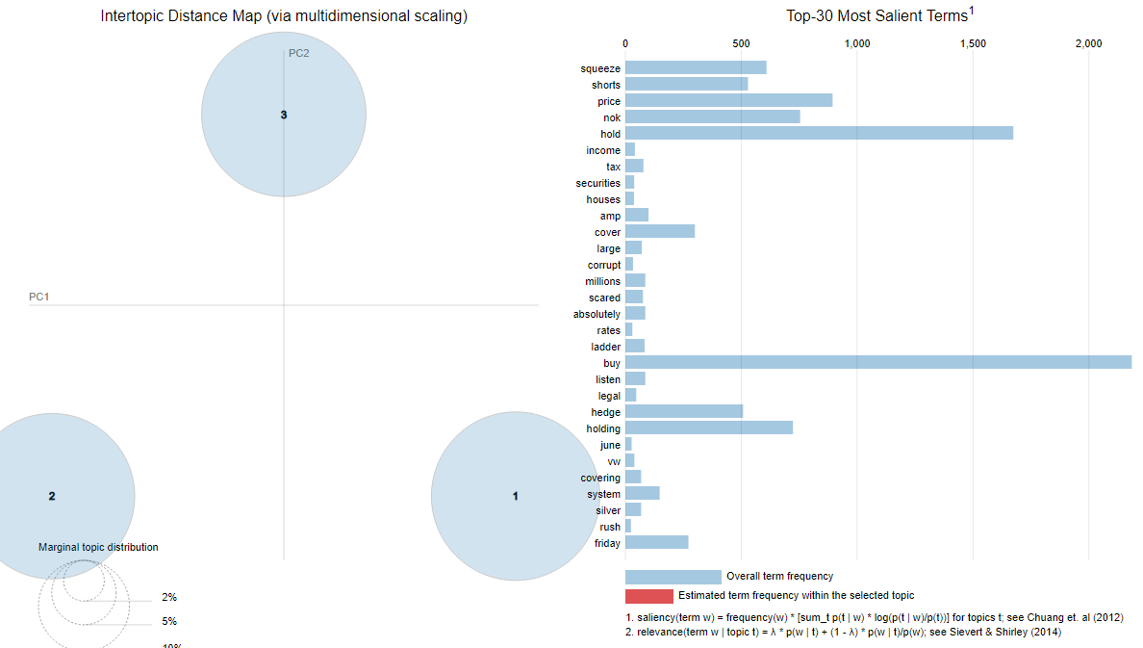
ANALYSIS: comments lda topic analysis

Slide 16
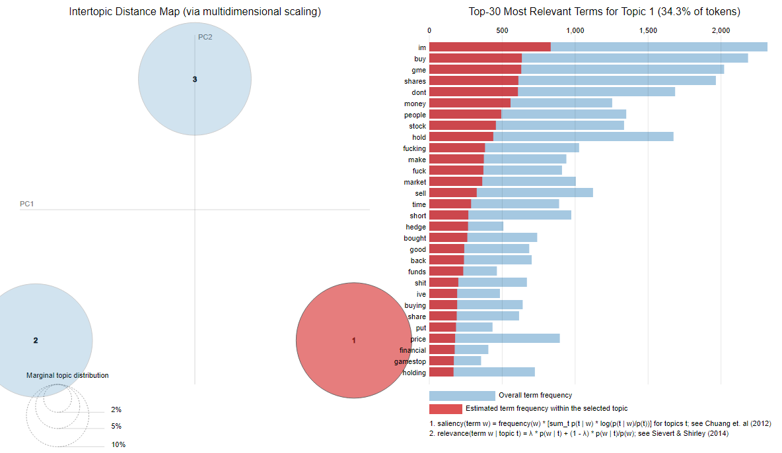
ANALYSIS: comments lda topic analysis

Slide 17
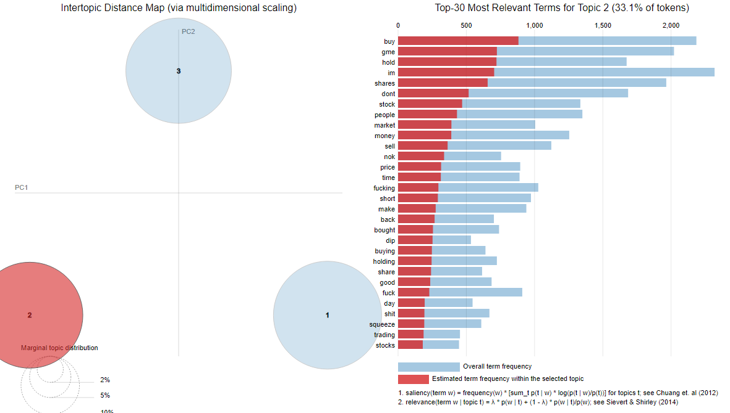
ANALYSIS: comments lda topic analysis

Slide 18
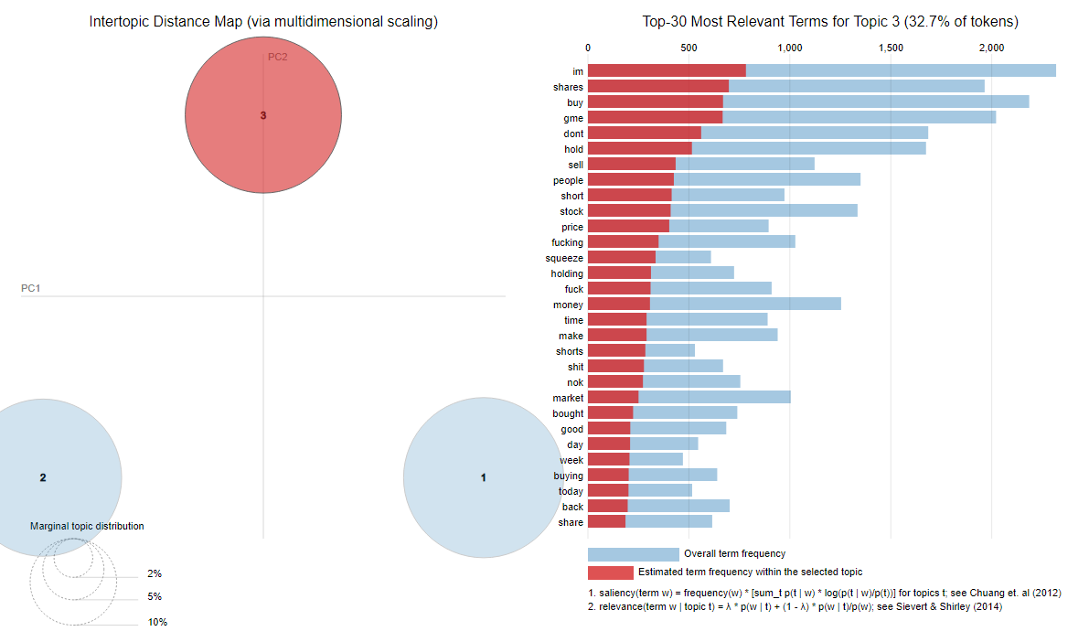
ANALYSIS: comments lda topic analysis

Slide 19
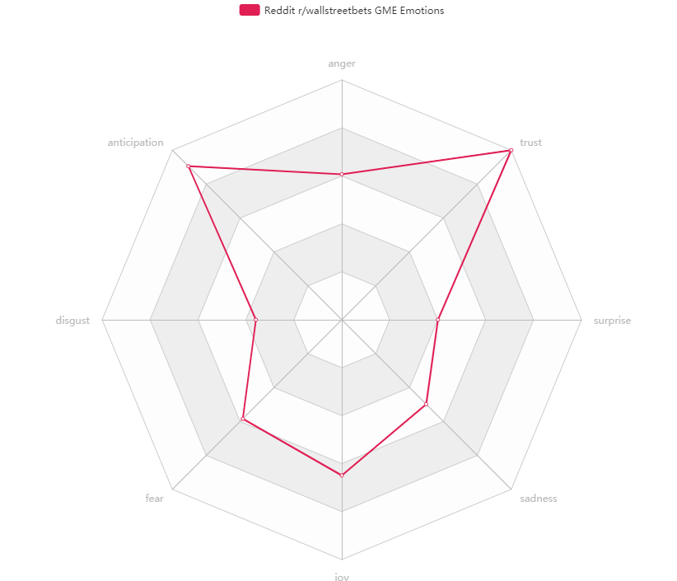
ANALYSIS: SENTIMENT ANALYSIS - emotions

Slide 20
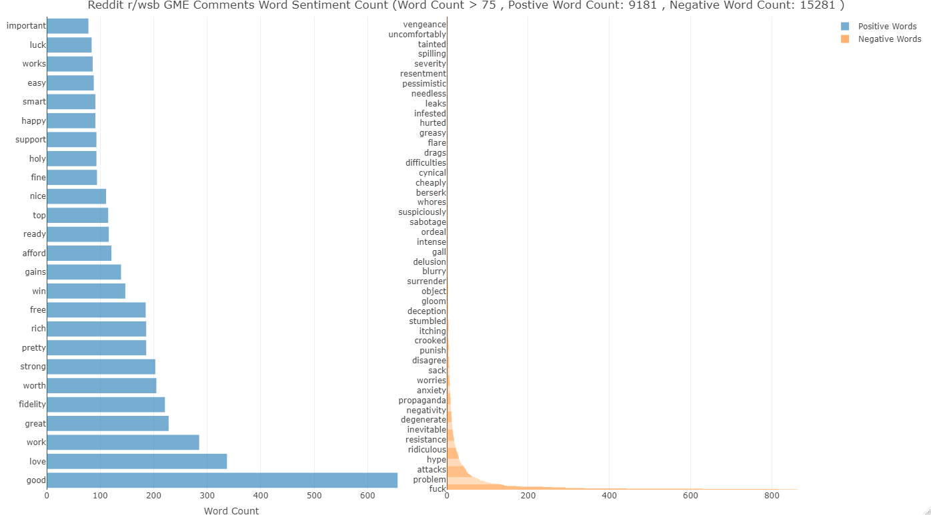
ANALYSIS: SENTIMENT ANALYSIS – Positive vs Negative words

Slide 21
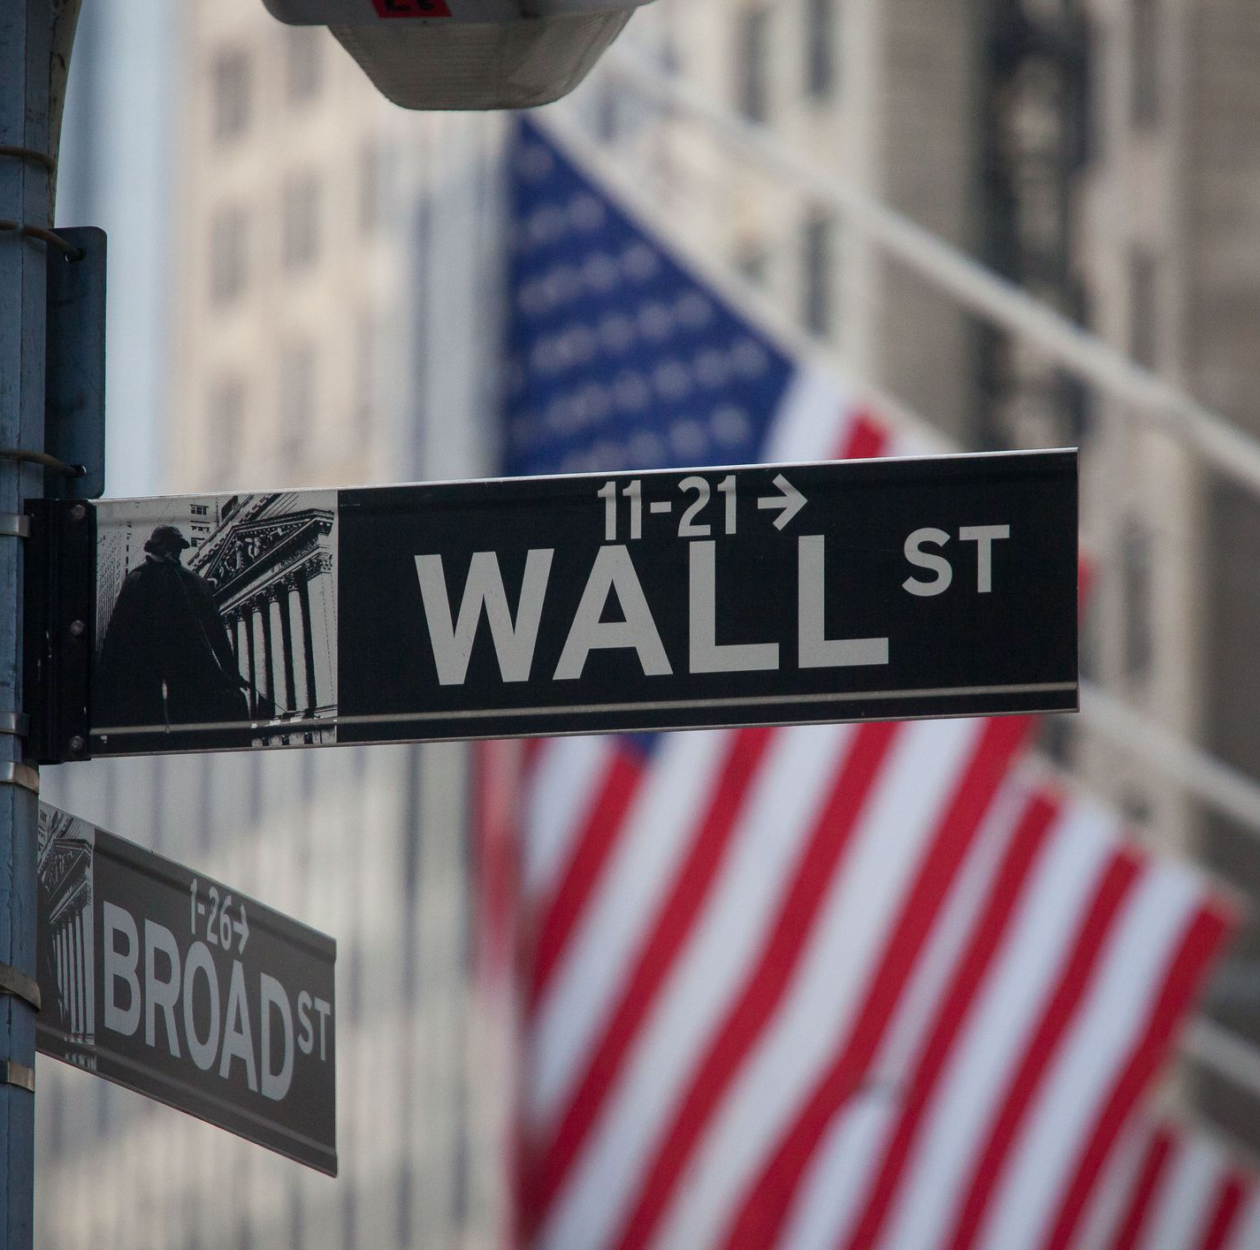
Conclusions
Social media market signals
Post / Comment volume and score
Comment word frequencies
buy (1st)
hold (4th)
Bigrams – can provide a sense of what’s going on
Salient Terms – “buy” and “hold” are the highest
Sentiment – high level of trust and anticipation
Future Work
Custom sentiment vocabularies tuned to different communities

